Slide 1


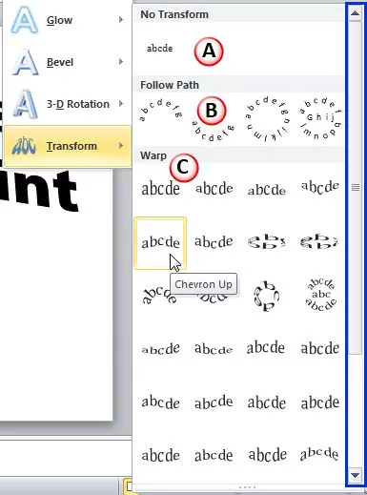

Introduction to String Transformation
This presentation will explore the fascinating concept of string transformation, where we can manipulate a string by removing a suffix and appending it to the beginning. We'll dive into the problem statement, the approach, and various techniques to handle complex scenarios.
BY
Mano Karthik Reddy .V
192225077
AI&ML

Slide 2

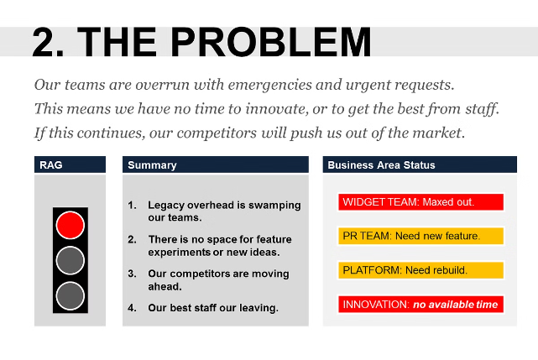
Problem Statement
1
Given Strings
2
Transformation Operation
Two strings, s and t, of equal length n.
Remove a suffix of s with length l, where 0 < l < n, and append it to the start of s.
3
Goal
Find the number of ways to transform s into t in exactly k operations.

Slide 3
Approach Overview
Generating Transformations
Tracking Steps
Optimizing Complexity
Systematically generate all possible transformations by removing and appending suffixes.
Keep track of the number of operations required to transform s into t.
Implement efficient techniques to handle large inputs and optimize time complexity.

Slide 4

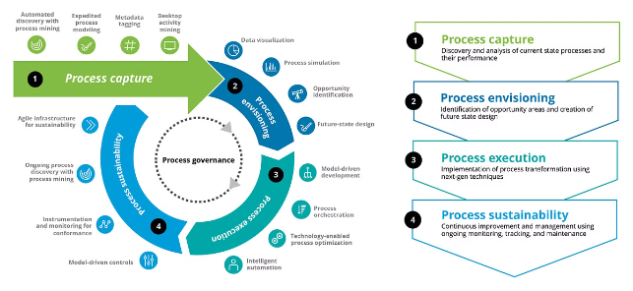
Generating Possible Transformations
1
Identify Suffixes
Iterate through all possible suffix lengths (1 to n-1) and remove each suffix.
2
Append to Beginning
Append the removed suffix to the start of the string.
3
Track Transformation
Record each transformation and the number of operations required.

Slide 5

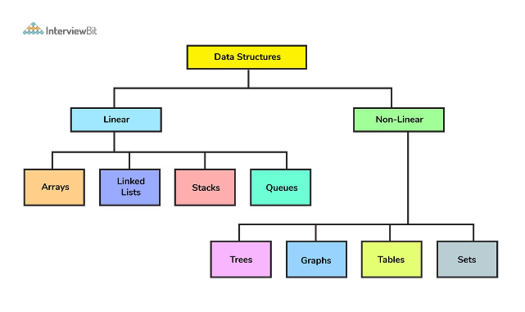

Tracking Transformation Steps
Memoization
Backtracking
Use a hash table or a dynamic programming approach to store and reuse previously computed transformations.
Explore all possible transformation paths and keep track of the number of operations performed.
Iterative Approach
Pruning
Implement an iterative solution to efficiently traverse the transformation space.
Identify and avoid redundant or unnecessary transformations to optimize the search process.

Slide 6
Handling Large Inputs
Memory Management
Parallelization
Approximation Algorithms
Implement techniques to efficiently store and access the transformation data, especially for large inputs.
Explore opportunities for parallel processing to speed up the transformation search on multi-core systems.
Develop heuristic-based approaches to provide approximate solutions for large inputs when an exact solution is infeasible.

Slide 7

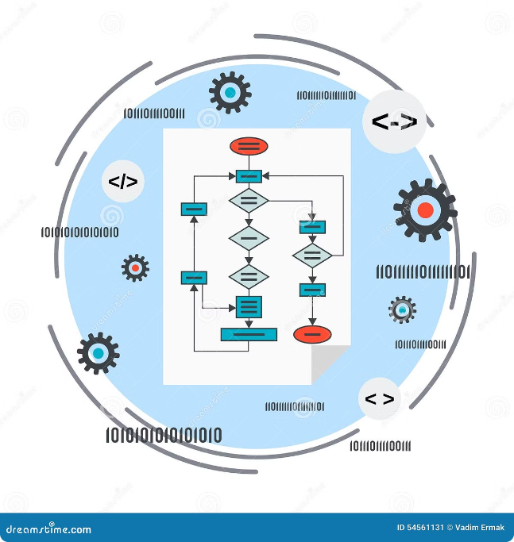




Optimizing Time Complexity
Complexity Analysis
Pruning Techniques
Thoroughly analyze the time and space complexity of the proposed algorithms and identify areas for optimization.
Develop efficient pruning strategies to eliminate unnecessary transformations and reduce the search space.
Dynamic Programming
Parallel Processing
Leverage dynamic programming techniques to reuse previously computed results and avoid redundant work.
Explore opportunities for parallelization to distribute the transformation search across multiple processors or threads.

Slide 8






Edge Cases and Considerations
Empty Strings
Handle the case where s or t is an empty string.
Identical Strings
Consider the scenario where s and t are initially the same.
Negative k
Gracefully handle the case when k is negative or exceeds the maximum number of possible transformations.
Precision Handling
Ensure accurate counting of the number of transformations, especially for large values.

Slide 9


Implementing the Solution
Algorithm
Pseudocode
Suffix Removal and Appending
1. Iterate through all possible suffix lengths (1 to n-1) 2. Remove the suffix from s 3. Append the removed suffix to the start of s 4. Record the transformation and the number of operations
Memoization and Backtracking
1. Use a hash table to store previously computed transformations 2. Explore all possible transformation paths 3. Keep track of the number of operations performed 4. Prune unnecessary transformations to optimize the search

Slide 10


Conclusion and Key Takeaways
1
Systematic Approach
2
Optimization Techniques
Develop a structured approach to generate and track string transformations.
Leverage memoization, pruning, and parallel processing to improve efficiency.
3
Edge Case Handling
4
Continuous Improvement
Carefully consider and address edge cases to ensure robust and reliable solutions.
Analyze and refine the algorithms to achieve better time and space complexity.

